Slide 1
High5 PORTFOLIO – what is it and why is it worth to have it?
http://blog.aicpa.org/images/post_images/CPA-career-development.jpg

Slide 2
What is a portfolio?
Portfolio is a kind of a personal archive with the examples of your own achievements. It can be in a shape of ring binder or in an electronic version.
The point is that you collect documents, which confirm drectly your abilities and capabilities.
https://encrypted-tbn1.gstatic.com/images?q=tbn:
ANd9GcT9alc5r244lBP2yPwpD47VdVH08s2Exb7a7_rNwF_1JWTrSVjVCg

Slide 3
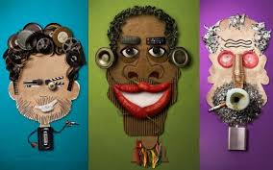
Idea of portfolio
The portfolio method has been used for many years in European and American schools
The portfolio idea comes from the world of finances and many creative professions. Investors, painters, architects, journalists collect their best works to emphasize the quality of what they do
Portfolio is also recognised
as a new form of CV
http://indywidualizacja-nauczania.pl/index.php/nasze-pomysly/metoda-portfo
https://encrypted-tbn0.gstatic.com/images?q=tbn:ANd9GcSSQP-YkNtsRrrZdCbWdPMeixN8j-d_1mwxkCfKcmVXU4CqXnZb

Slide 4
Ogólne cele portfolio
The general goals of portfolio
I learn self-reliance and take over the responsibility for my own learning process
I learn about the self-presentation
I gather and organise
data about myself
I systematically monitor my own development.
I assess effectiveness
of my own activities
I shape the habit of never-ending planning of self-development and consistent pursuit to achieve the objectives
zdjęcie: https://encrypted-tbn3.gstatic.com/images?q=tbn:ANd9GcTy7_eIiYDLq9H6cS12OP8UKQFRk6U3kMmSiEhuN2ZMkQpSNxFS

Slide 5
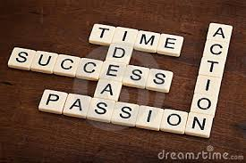
Użyteczne portfolio
A functional portfolio
… has a clearly defined objective
… is systematically carried out according to the established rules
… is designed imaginatively
… is presented and assessed by the others
zdjęcie: https://www.google.pl/search?q=success+photos&espv=2&biw=1024&bih=548&tbm=isch&tbo=u&source=univ&sa=X&ei=n6pMVOCLEMzpav7RAg&ved=0CCIQsAQ

Slide 6
The idea of school High5 Portfolio
http://diplolearn.files.wordpress.com/2012/04/creativity.jpg
http://www.zaprogramujsie.pl/Portals/_default/Skins/ZaprogramujSieNew/images/kreatywnos
GOAL
Preparation for independent and active shaping of your own career’s path
Part I:
„From creativity to entrepreneurship” Part II:
„Planning of career’s path”

Slide 7
Development of the attitude of openness to knowledge and presenting your personality
Presentation of own school and non-school experiences (knowledge and abilities, interests, created objects) to the selected people and obtaining feedback about yourself
Dealing with difficult and stressful situations
zdjęcie: https://encrypted-tbn3.gstatic.com/images?q=tbn:ANd9GcTGXQePBV4-aGpj23UfIKHixYcQ7MqSTKFchZNlLaGjtKR7r3DgUA

Slide 8
Planning of professional path
Analysing the knowledge with the regard to: interests, abilities,talents with some reflexion
Discovering own competences and professional predispositions
Awakening and delivering the knowledge about „the world of professions”
Learning educational and professional paths
Learning and understanding current trends on the job market
Support from parents and cooperation with experts
zdjęcia: https://encrypted-tbn0.gstatic.com/images?q=tbn:ANd9GcT5mpJ6Xx7mrTD3-jyPCyUMLPfL4Qxv3dUcu-M8zvV33fn9VRakQA
https://encryptedtbn0.gstatic.com/images?q=tbn:ANd9GcT8uAPLJ2OyWMNQxIIvdwuF4ylBnas0vmSOLg2Iuecpy8iD4KhgHg

Slide 9
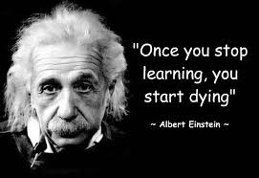
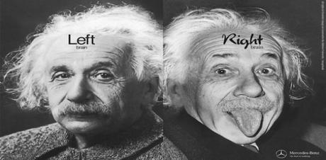
Lifelong learning
Development of abilities of creative learning about yourself
The formation of habits of continuous self-development planning and consistent efforts to achieve the objectives
Creating active attitudes, overcoming passivity and lack of commitment
https://encrypted-tbn0.gstatic.com/images?q=tbn:ANd9GcSfIBqPyZg0GKuZMAfdFJ-NTpIcJGP9GaW5tx6m9GT4GID501-fbw

Slide 10
Bibliography
https://encryptedtbn3.gstatic.com/images?q=tbn:ANd9GcTy7_eIiYDLq9H6cS12OP8UKQFRk6U3kMmSiEhuN2ZMkQpSNxFS
https://www.google.pl/search?q=career+photos&espv=2&biw=1024&bih=548&tbm=isch&tbo=u&source=univ&sa=X&ei=IpVMVJGXI9jXapbPgdAE&ved=0CCIQsAQ
http://www.ore.edu.pl/strona-ore/index.php?option=com_phocadownload&view=category&id=60:europejskie-portfolio-jzykowe&Itemid=1063
https://www.google.pl/search?q=creativity+photos&espv=2&biw=1024&bih=548&tbm=isch&tbo=u&source=univ&sa=X&ei=YZ9MVO3LMtjtaNWAgtAD&ved=0CB8QsAQ
https://www.google.pl/search?espv=2&biw=1024&bih=548&tbm=isch&source=univ&sa=X&ei=eZ1MVKeIJYL-aJ6tgNAD&ved=0CCkQsAQ&q=portfolio%20zdj%C4%99cia#tbm=isch&q=portfolio+career+photos
https://sites.google.com/site/reflection4learning/elementary-school
http://osswiata.pl/strzemieczny/2014/04/29/edukacyjne-e-portfolio-zaprosze
http://indywidualizacja-nauczania.pl/index.php/nasze-pomysly/metoda-portfo
http://www.ceo.org.pl/sites/default/files/EWP/davBinary/1.zalacznik_nr_3._instrukcja_do_e-portfolio.pdf

