Slide 1
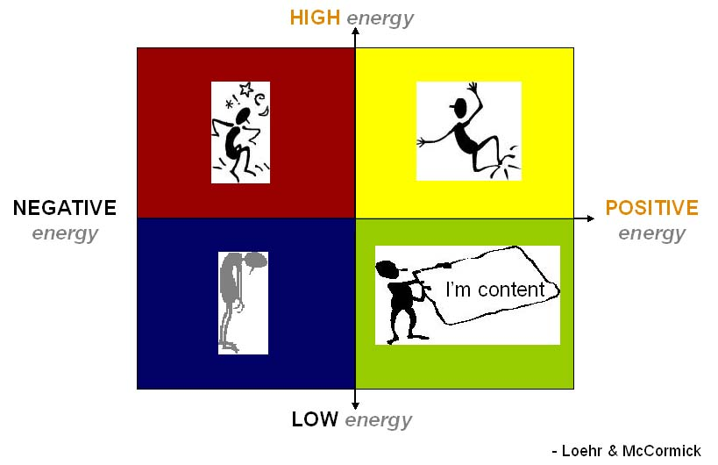
CAREER PORTFOLIO H5 – annex 3 (How to manage own energy)
PZS Oborniki Śląskie 2014
https://www.mi5.gov.uk/files/Global/Careers/skills-knowledge-abilities.jpg
http://omaram.hypermart.net/energy.jpg

Slide 2
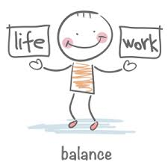
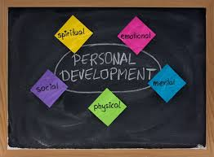
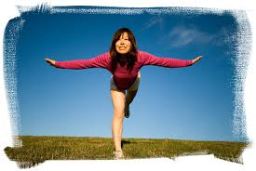
A short theory!!!
The mind and the body are connected
"It is good to feel my whole body, and to be fit and energized"
(Robert Stuart Polster)
https://encrypted-tbn0.gstatic.com/images?q=tbn:ANd9GcQdXKtBDhejAMXP7d4aGvg7lQFLrKVt_eDUGhihcEbyDeonohVV
https://encrypted-tbn0.gstatic.com/images?q=tbn:ANd9GcRzZ009lrAZNPUmvpIkz88_7ZyQX3zeO48m9waQLIwUi0ictY1l
https://encrypted-tbn1.gstatic.com/images?q=tbn:ANd9GcQrGeV-uwHAZkne-X2FvbyLoHOAhrVs6_fMcN6vKUvdZKAJF5Uf2w

Slide 3
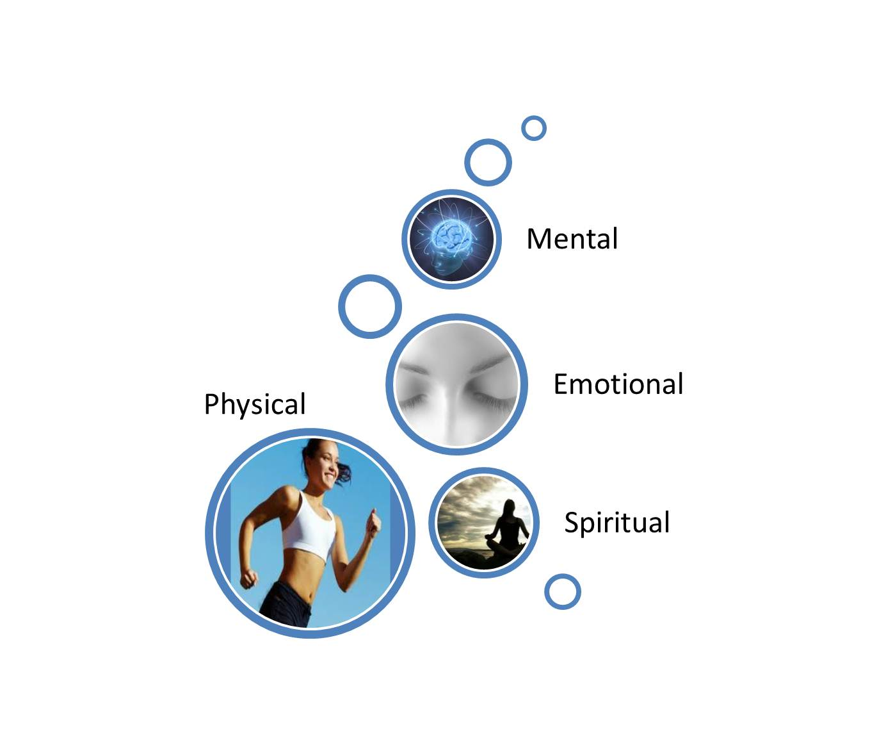
Self-assessment: 4 dimensions of your energy
You should strive for increasing your endurance and your strength
The appropriate dose of energy is the most important factor to combat stress and the key to a life full of optimism and a positive self-expression
(Robert Stuart Polster)

Slide 4
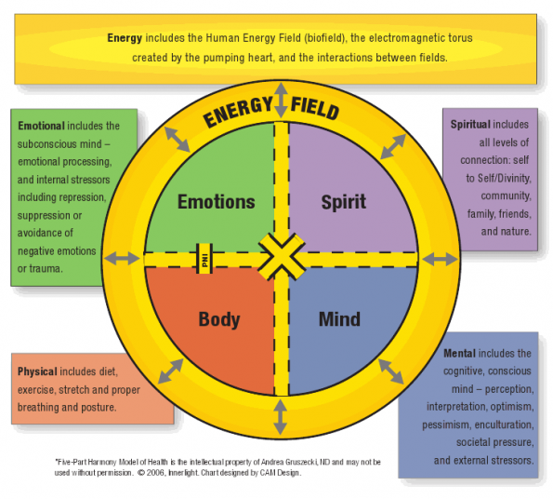
https://ndnr.com/wp-content/uploads/2013/06/figure1.png

Slide 5
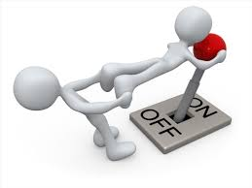
Unlock your energy! Be open for new ideas!
Remember not to exercise immediately after a meal
Coordinate breathing and posture
Develop your own pace
Work on your self-discipline
If there are any contraindications, prepare your own set of relaxation exercises
https://encrypted-tbn3.gstatic.com/images?q=tbn:ANd9GcTiZO5rl3Na_BimZFjv0t9o_I3NnbrTZJ7limZIbpksHr2IZ92X
https://encrypted-tbn0.gstatic.com/images?q=tbn:ANd9GcTh7f_oYf4RtECusfdLlP34a2Tr2RqHggkq3-NaUkrveh8icUXn6w

Slide 6
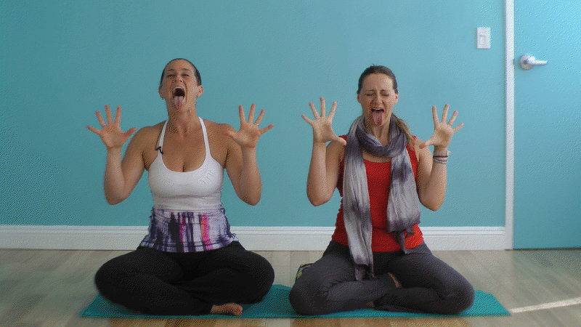
Unlock your energy! Learn to breathe and relax
Watch video on youtube!
1. Simple YOGA exercises to relax body and mind at work
https://www.youtube.com/watch?v=fp4IxXVJv4o
2. Kundalini Yoga : Kundalini Yoga Breathing Exercises
https://www.youtube.com/watch?v=e5tGCr22TlA
3. Kim Eng. Meditation-whole body breathing – Polish lector. Eckhard Tolle TV
https://www.youtube.com/watch?v=ERFfKAToJ1w
http://www.yogavibes.com/wp-uploads/2012/09/online-yoga-lionsbreath.png
https://encrypted-tbn3.gstatic.com/images?q=tbn:ANd9GcSU2qlRq_uhKk0LTB6PFrp_b8HXpILkcvb5M_DYPDDlsDWNvC9m

Slide 7
Video on youtube: „Sun Salutation”
1. Yoga for Beginners - Sun Salutation A
https://www.youtube.com/watch?v=uMV4Nq6jpu0
If there are any contraindications, prepare its own set of relaxation exercises

Slide 8
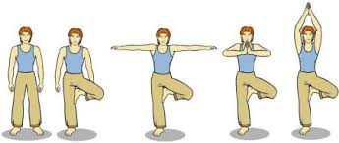
Video youtube: „Tree Pose”
2. Rodney Yee: Balance with Tree Pose
How to Do the Tree Pose
https://www.youtube.com/watch?v=2adJ9dAT22k
”
https://www.google.pl/search?q=tree+pose+step+by+step&espv=2&biw=1024&bih=514&tbm=isch&tbo=u&source=univ&sa=X&ei=IsR1VIyQNYjnaK6CgYgE&ved=0CCsQsAQ
http://thehouseofyoga.co.uk/wp-content/uploads/2014/04/tree-collage.jpg

Slide 9
PRACTICAL EXERCISE: TWO HANDED DRAWING EXERCISES WARMING UP Practice drawing with both hands at the same time to improve your creativity and become Ambidextrous
https://cdn.tutsplus.com/vector/uploads/2013/10/whycantyoudraw_2-2_stickmen.png

Slide 10
Tasks to annex 3a: self-discipline
Learn relaxation exercises „Sun Salutations" and "Trees”. After you learn the sequence of movements choose the music
Work on your self-discipline. Keep doing the exercise for 4 minutes during 10 days at any time of a day (preferably during the breaks in the intellectual work)
Remember to breath and not to do the exercise immediately after a meal. If you have a problem with balance you can do the „Tree pose" next to the wall. If there are any contraindications, prepare your own set of relaxation exercises
Think about the impact of regular exercise on your body and well-being
There will be organized a competition at school for the best group / class performance of „Sun Salutations" and "Trees".

Slide 11
Tasks for annex 3b: my energy ( do it after watching at school with your tutor the presentation „How to manage own energy”)
1. New energy gives me: …………………………………………………………………………………………………………………………………………………………………………………….
2. My energy decreases: ……………………………………………………………………………………………………………………………………………………………………………………………………………………………………………………………………………….
3. I relax: ……………………………………………………………………………………………………………………………………………………………………………………………………………………………………………………………………………….
4. Do you regularly take care of the development of your 4 energy resources:
Mental energy: yes average not to much enough never
Emotional energy: yes average not to much enough never
energia duchowa: yes average not to much enough never
energia fizyczna: yes average not to much enough never
5. Comments: ……………………………………………………………………….

Slide 12
Tasks for annex 3c: my documents
1. Add to the portfolio all of the diplomas, certificates etc. from school and extracurricular activities for the last 3-4 years. Complete the following table
Type of certificate, diplomas | Number of diplomas, certificates, etc | Do you continue development in the field and how
Humanistic and linguistic
Scientific
Mathematical and physical
Sport

Slide 13
Evaluation: What have I learned about myself
1. Can the attached diplomas/list of courses be helpful with the taking decision about your future professions
a) yes b) no c) can be useful d) I do not know d) I do not have any documents/courses
f) ..................... .................... ................................................. (another answer)
2. How can you describe your attitude towards task „Sun Salutation" and "The Tree".
You can tick more answers:
a) immediately I criticized and I forestalled the task
b) It was boring but I saw the sense of them and I decided to endure
c) It bored me, but I diversified exercises to my liking
d) I like to experience new things
e) I see the positive effects of exercises for me /I do not see the positive effects of exercise for me
f) I have been suggested the opinion of others and have had the same attitude towards tasks
g) I searched for additional information, videos of the exercises, etc
h) I practiced my endurance
i) With the systematic doing of exercises I found pleasure and I understood the meaning
j) I`m continuing to train my body and mind. I spend minimum 4 minutes doing various exercises to relax and focuse my concentration every day.
k) It has been completely useless to me. I do not do any short exercises to relax my body and mind.
l) Other answer / comments:
………………………………………………………………………………………………………………………………………………………………………………………………………………………………………………………………………………………………………………………………………………………………………
ASSESSMENT OF MY COMMITMENT and self-discipline (4 min. A day for 10 days or longer ☺)
(from 0 do max 6) ……………………………………………

Slide 14
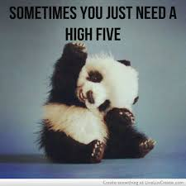
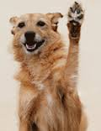
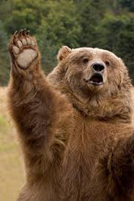
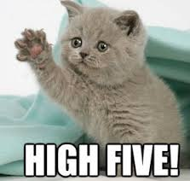
Print, fill in and attach slides 3, 8, 9, 10
Bring your Career Portfolio to your tutor in January
HIGH FIVE!
https://encryptedtbn3.gstatic.com/images?q=tbn:ANd9GcTLQJmrfSTEGuAk5jE012Xh8gro1qjIn8SbUEoMiv8UorzjpfpnqQ
https://encrypted-tbn0.gstatic.com/images?q=tbn:ANd9GcS1BShHX6J52PV6zYo2U_Hd9TsNKnCulaVpSCFmyzALg03TIIIiw
https://encrypted-tbn0.gstatic.com/images?q=tbn:ANd9GcSYU4-IwlxYOUtrH4PmH9RU5sFG2e26skITOlk52nbnqo8dDeo4
https://encrypted-tbn2.gstatic.com/images?q=tbn:ANd9GcRHkSAfTQnY4APixJphAF--EKf6SV4WmZjdokWNdq3logeetkK0

